Slide 1
More with Modules
Unit 4.3
Cybersecurity Boot Camp |

Slide 2
Today’s Goals
By the end of class, you will be able to:
Return a file's metadata using the os.stat() function
Use functions to get the size of a file, when it was last accessed, and when it was last modified
Convert dates and times from one format to another using the the datetime module
Remove files from a system using the os.remove() function.
Extract zip files using the zipfile module.
Notes:
Review goals; address any questions.

Slide 3
Warm-up Activity: Walking the Maze (15 min)
In this activity, you will create a script that automatically navigates through a complex web of folders to discover the files that it contains before printing those files to the screen.
Instructions:
Unzip TheMaze.zip.
Create a Python application that automatically navigates through TheMaze folder that you have been given.
When you find a file within TheMaze folder, print the location of this file to the screen alongside the contents of that file.
We've provided a lot of the solution code for you in the solution file, and the comments should guide you the rest of the way.

Slide 4
Walking the Maze
Instructor Review

Slide 5
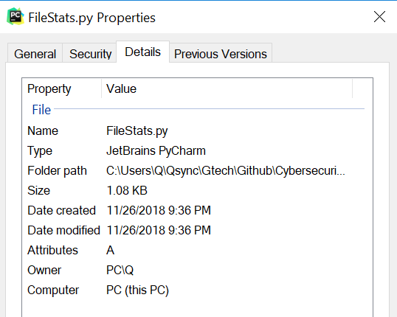
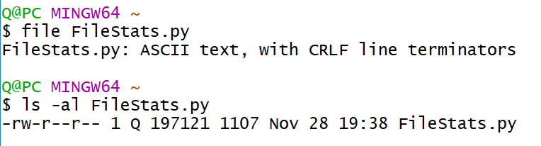
Metadata
“a set of data that describes and gives information about other data”
File metadata gives you information “about the file” – things like file type, file size, file source, last accessed, last modified, etc.

Slide 6
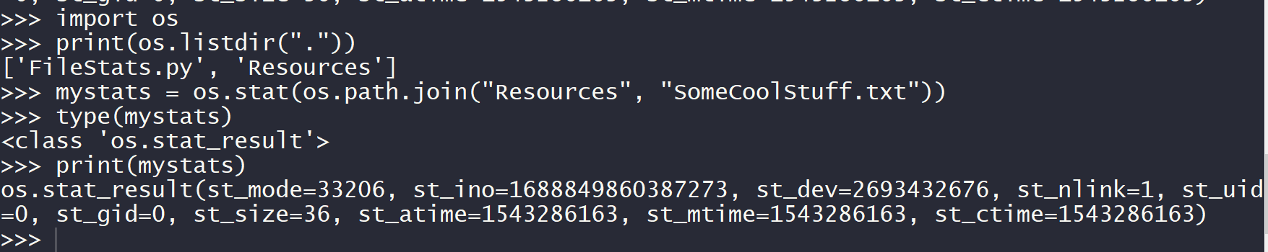
Metadata with os.stat()
os.stat(path, *, dir_fd=None, follow_symlinks=True)
Get the status of a file or a file descriptor.
Return a stat_result object.
See https://docs.python.org/3/library/os.html#os.stat for details on what the results mean.

Slide 7
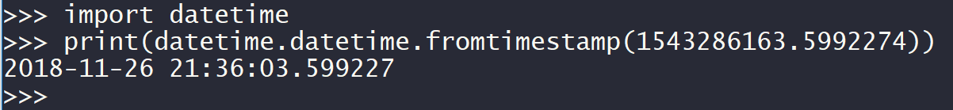
Date & Time in Python
os.stat() gives us a “timestamp”
in a format known as Unix Epoch time
This format is based on a counter that has been going up by one every second since 00:00:00 Coordinated Universal Time (UTC), Thursday, January 1, 1970
To convert this timestamp to human-readable date-time object, Python provides us datetime module
import datetime
print(datetime.datetime.fromtimestamp(“1543286163.5992274”))
For other ways to represent date-time through datetime module, see https://docs.python.org/3/library/datetime.html

Slide 8
Metadata
import os
file_path = os.path.join("Resources", "SomeCoolStuff.txt")
statInfo = os.stat(file_path)
print(statInfo.st_size)
timeAccessed = statInfo.st_atime import datetime
timeAccessed = datetime.datetime.fromtimestamp(timeAccessed).strftime('%c')
print(timeAccessed)
timeChanged = statInfo.st_mtime
timeChanged = datetime.datetime.fromtimestamp(timeChanged).strftime('%c')
print(timeChanged)
os.remove("Resources/BigOlWallpaper.jpg")
Import the os module

Slide 9
Metadata
import os
file_path = os.path.join("Resources", "SomeCoolStuff.txt")
statInfo = os.stat(file_path)
print(statInfo.st_size)
timeAccessed = statInfo.st_atime import datetime
timeAccessed = datetime.datetime.fromtimestamp(timeAccessed).strftime('%c')
print(timeAccessed)
timeChanged = statInfo.st_mtime
timeChanged = datetime.datetime.fromtimestamp(timeChanged).strftime('%c')
print(timeChanged)
os.remove("Resources/BigOlWallpaper.jpg")
Create a reference to the file path that you want to analyze

Slide 10
Metadata
import os
file_path = os.path.join("Resources", "SomeCoolStuff.txt")
statInfo = os.stat(file_path)
print(statInfo.st_size)
timeAccessed = statInfo.st_atime import datetime
timeAccessed = datetime.datetime.fromtimestamp(timeAccessed).strftime('%c')
print(timeAccessed)
timeChanged = statInfo.st_mtime
timeChanged = datetime.datetime.fromtimestamp(timeChanged).strftime('%c')
print(timeChanged)
os.remove("Resources/BigOlWallpaper.jpg")
Collect the stats and save it to a variable

Slide 11
Metadata
import os
file_path = os.path.join("Resources", "SomeCoolStuff.txt")
statInfo = os.stat(file_path)
print(statInfo.st_size)
timeAccessed = statInfo.st_atime import datetime
timeAccessed = datetime.datetime.fromtimestamp(timeAccessed).strftime('%c')
print(timeAccessed)
timeChanged = statInfo.st_mtime
timeChanged = datetime.datetime.fromtimestamp(timeChanged).strftime('%c')
print(timeChanged)
os.remove("Resources/BigOlWallpaper.jpg")
To collect the file size in bytes...

Slide 12
Metadata
import os
file_path = os.path.join("Resources", "SomeCoolStuff.txt")
statInfo = os.stat(file_path)
print(statInfo.st_size)
timeAccessed = statInfo.st_atime import datetime
timeAccessed = datetime.datetime.fromtimestamp(timeAccessed).strftime('%c')
print(timeAccessed)
timeChanged = statInfo.st_mtime
timeChanged = datetime.datetime.fromtimestamp(timeChanged).strftime('%c')
print(timeChanged)
os.remove("Resources/BigOlWallpaper.jpg")
To collect the last time the file was accessed (opened) in unix epoch time...

Slide 13
Metadata
import os
file_path = os.path.join("Resources", "SomeCoolStuff.txt")
statInfo = os.stat(file_path)
print(statInfo.st_size)
timeAccessed = statInfo.st_atime import datetime
timeAccessed = datetime.datetime.fromtimestamp(timeAccessed).strftime('%c')
print(timeAccessed)
timeChanged = statInfo.st_mtime
timeChanged = datetime.datetime.fromtimestamp(timeChanged).strftime('%c')
print(timeChanged)
os.remove("Resources/BigOlWallpaper.jpg")
Epoch time is annoyingly hard to read, so let's convert that into an actual datetime format

Slide 14
Metadata
import os
file_path = os.path.join("Resources", "SomeCoolStuff.txt")
statInfo = os.stat(file_path)
print(statInfo.st_size)
timeAccessed = statInfo.st_atime import datetime
timeAccessed = datetime.datetime.fromtimestamp(timeAccessed).strftime('%c')
print(timeAccessed)
timeChanged = statInfo.st_mtime
timeChanged = datetime.datetime.fromtimestamp(timeChanged).strftime('%c')
print(timeChanged)
os.remove("Resources/BigOlWallpaper.jpg")
This takes the timeAccessed timestamp and converts it into a much more comprehensive form

Slide 15
Metadata
import os
file_path = os.path.join("Resources", "SomeCoolStuff.txt")
statInfo = os.stat(file_path)
print(statInfo.st_size)
timeAccessed = statInfo.st_atime import datetime
timeAccessed = datetime.datetime.fromtimestamp(timeAccessed).strftime('%c')
print(timeAccessed)
timeChanged = statInfo.st_mtime
timeChanged = datetime.datetime.fromtimestamp(timeChanged).strftime('%c')
print(timeChanged)
os.remove("Resources/BigOlWallpaper.jpg")
To collect the last time the file was modified (changed) in unix epoch time...

Slide 16
Metadata
import os
file_path = os.path.join("Resources", "SomeCoolStuff.txt")
statInfo = os.stat(file_path)
print(statInfo.st_size)
timeAccessed = statInfo.st_atime import datetime
timeAccessed = datetime.datetime.fromtimestamp(timeAccessed).strftime('%c')
print(timeAccessed)
timeChanged = statInfo.st_mtime
timeChanged = datetime.datetime.fromtimestamp(timeChanged).strftime('%c')
print(timeChanged)
os.remove("Resources/BigOlWallpaper.jpg")
If a potentially malicious file is uncovered, sometimes it is best to just remove it immediately
This can be done using os.remove()

Slide 17
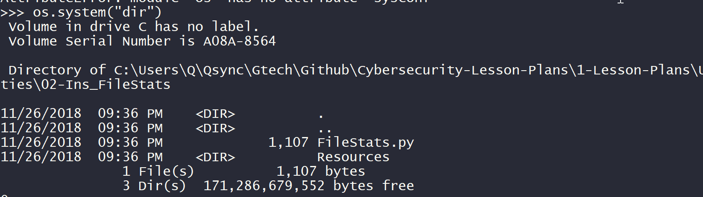
Hey OS! Do Things For Me

Slide 18
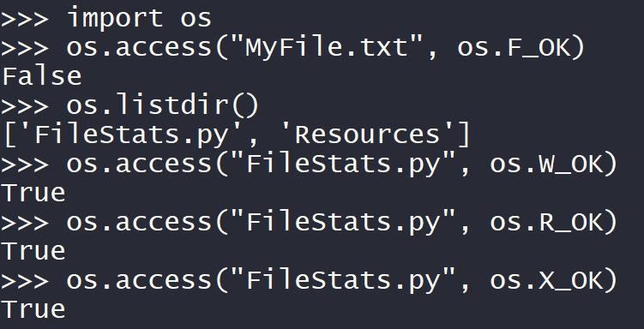
File Access Permissions
os.access(path, mode)
https://docs.python.org/3/library/os.html#os.access
Modes are:
os.F_OK → Does the file exist?
os.R_OK → Can I read the file?
os.W_OK → Can I write to the file?
os.X_OK → Can I execute the file (think scripts, installers, etc.)?

Slide 19
Activity: Searching the Red Flag Sea (25 min)
In this activity, you're going to write a script that searches a folder for any files that seem out of place. All of the files should be the same size and have been modified around the same time, but some may have had some additional changes made to them and they should stand out. Instructions:
Unzip Text.zip.
Write a Python script that reads through all of the files in the Text folder. The script should print out a line that looks like the following for each file:
File Name, File Size, Last Modified Date.
Example: Text\zrJ1cdXhuZOB, 100, Sun Jul 29 10:55:57 2018
We've provided a lot of the solution code for you in the solution file, and the comments should guide you the rest of the way.

Slide 20
Searching the Red Flag Sea
Instructor Review

Slide 21
Today’s Goals
By the end of class, you will be able to:
Return a file's metadata using the os.stat() function
Use functions to get the size of a file, when it was last accessed, and when it was last modified
Convert dates and times from one format to another using the the datetime module
Remove files from a system using the os.remove() function.
Extract zip files using the zipfile module.
Notes:
Review goals; address any questions.

Slide 22
Activity: Red Flag CSV (10 min)
In this follow up activity, you will go into the code you just wrote for the Red Flag Sea activity and modify it so that, instead of printing the information to the screen, your application creates a new CSV with the file metadata inside of it instead of printing the information to the screen.
Instructions:
Using the previous activity as a jumping off point, modify the application so that instead of printing out all of the file metadata to the screen, it will instead create a CSV file that holds all of the information instead.
You only need to add and modify two lines of your original code. We provided the script file for you with where this needs to happen.

Slide 23
Red Flag CSV
Instructor Review

Slide 24
import os
import datetime
csvFile = open("RedFlags.csv", "w")
for root, dirs, files in os.walk('Text'):
print("GETTING FILE INFO")
for file_name in files:
file_path = os.path.join(root, file_name)
fileInfo = os.stat(file_path)
timeModified = fileInfo.st_mtime
timeModified = datetime.datetime.fromtimestamp(
timeModified).strftime('%c’)
fileSize = fileInfo.st_size
csvFile.write(file_path + "," + str(fileSize) + "," + timeModified + "\n")
csvFile.close()
Import the two modules that will be used in this code

Slide 25
import os
import datetime
csvFile = open("RedFlags.csv", "w")
for root, dirs, files in os.walk('Text'):
print("GETTING FILE INFO")
for file_name in files:
file_path = os.path.join(root, file_name)
fileInfo = os.stat(file_path)
timeModified = fileInfo.st_mtime
timeModified = datetime.datetime.fromtimestamp(
timeModified).strftime('%c’)
fileSize = fileInfo.st_size
csvFile.write(file_path + "," + str(fileSize) + "," + timeModified + "\n")
csvFile.close()
Create a connection to the CSV file this application will write to

Slide 26
import os
import datetime
csvFile = open("RedFlags.csv", "w")
for root, dirs, files in os.walk('Text'):
print("GETTING FILE INFO")
for file_name in files:
file_path = os.path.join(root, file_name)
fileInfo = os.stat(file_path)
timeModified = fileInfo.st_mtime
timeModified = datetime.datetime.fromtimestamp(
timeModified).strftime('%c’)
fileSize = fileInfo.st_size
csvFile.write(file_path + "," + str(fileSize) + "," + timeModified + "\n")
csvFile.close()
Since there are so many files, os.walk would be wise

Slide 27
import os
import datetime
csvFile = open("RedFlags.csv", "w")
for root, dirs, files in os.walk('Text'):
print("GETTING FILE INFO")
for file_name in files:
file_path = os.path.join(root, file_name)
fileInfo = os.stat(file_path)
timeModified = fileInfo.st_mtime
timeModified = datetime.datetime.fromtimestamp(
timeModified).strftime('%c’)
fileSize = fileInfo.st_size
csvFile.write(file_path + "," + str(fileSize) + "," + timeModified + "\n")
csvFile.close()
Loop through all of the files in the current root

Slide 28
import os
import datetime
csvFile = open("RedFlags.csv", "w")
for root, dirs, files in os.walk('Text'):
print("GETTING FILE INFO")
for file_name in files:
file_path = os.path.join(root, file_name)
fileInfo = os.stat(file_path)
timeModified = fileInfo.st_mtime
timeModified = datetime.datetime.fromtimestamp(
timeModified).strftime('%c’)
fileSize = fileInfo.st_size
csvFile.write(file_path + "," + str(fileSize) + "," + timeModified + "\n")
csvFile.close()
Create the path to the current file

Slide 29
import os
import datetime
csvFile = open("RedFlags.csv", "w")
for root, dirs, files in os.walk('Text'):
print("GETTING FILE INFO")
for file_name in files:
file_path = os.path.join(root, file_name)
fileInfo = os.stat(file_path)
timeModified = fileInfo.st_mtime
timeModified = datetime.datetime.fromtimestamp(
timeModified).strftime('%c’)
fileSize = fileInfo.st_size
csvFile.write(file_path + "," + str(fileSize) + "," + timeModified + "\n")
csvFile.close()
Get the stats on the file, save to fileInfo variable

Slide 30
import os
import datetime
csvFile = open("RedFlags.csv", "w")
for root, dirs, files in os.walk('Text'):
print("GETTING FILE INFO")
for file_name in files:
file_path = os.path.join(root, file_name)
fileInfo = os.stat(file_path)
timeModified = fileInfo.st_mtime
timeModified = datetime.datetime.fromtimestamp(
timeModified).strftime('%c’)
fileSize = fileInfo.st_size
csvFile.write(file_path + "," + str(fileSize) + "," + timeModified + "\n")
csvFile.close()
Collect the last time at which the file was modified

Slide 31
import os
import datetime
csvFile = open("RedFlags.csv", "w")
for root, dirs, files in os.walk('Text'):
print("GETTING FILE INFO")
for file_name in files:
file_path = os.path.join(root, file_name)
fileInfo = os.stat(file_path)
timeModified = fileInfo.st_mtime
timeModified = datetime.datetime.fromtimestamp(
timeModified).strftime('%c’)
fileSize = fileInfo.st_size
csvFile.write(file_path + "," + str(fileSize) + "," + timeModified + "\n")
csvFile.close()
Change the format of timeModified to datetime format

Slide 32
import os
import datetime
csvFile = open("RedFlags.csv", "w")
for root, dirs, files in os.walk('Text'):
print("GETTING FILE INFO")
for file_name in files:
file_path = os.path.join(root, file_name)
fileInfo = os.stat(file_path)
timeModified = fileInfo.st_mtime
timeModified = datetime.datetime.fromtimestamp(
timeModified).strftime('%c’)
fileSize = fileInfo.st_size
csvFile.write(file_path + "," + str(fileSize) + "," + timeModified + "\n")
csvFile.close()
Collect the file size of the file

Slide 33
import os
import datetime
csvFile = open("RedFlags.csv", "w")
for root, dirs, files in os.walk('Text'):
print("GETTING FILE INFO")
for file_name in files:
file_path = os.path.join(root, file_name)
fileInfo = os.stat(file_path)
timeModified = fileInfo.st_mtime
timeModified = datetime.datetime.fromtimestamp(
timeModified).strftime('%c’)
fileSize = fileInfo.st_size
csvFile.write(file_path + "," + str(fileSize) + "," + timeModified + "\n")
csvFile.close()
Write the new line of data into the external CSV file

Slide 34
import os
import datetime
csvFile = open("RedFlags.csv", "w")
for root, dirs, files in os.walk('Text'):
print("GETTING FILE INFO")
for file_name in files:
file_path = os.path.join(root, file_name)
fileInfo = os.stat(file_path)
timeModified = fileInfo.st_mtime
timeModified = datetime.datetime.fromtimestamp(
timeModified).strftime('%c’)
fileSize = fileInfo.st_size
csvFile.write(file_path + "," + str(fileSize) + "," + timeModified + "\n")
csvFile.close()
Close the CSV file

Slide 35
BREAK

Slide 36
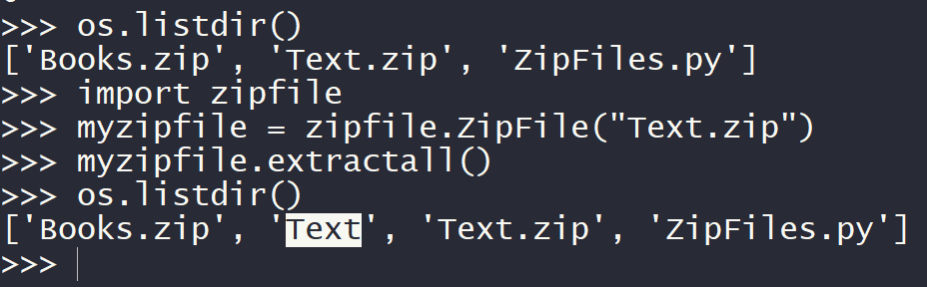
Zip Files
Zip file format is a common archive and compression standard
zipfile module provides tools to create, read, write, append, and list a ZIP file

Slide 37
Activity: Zip-A-Dee-Doo-Dah (10 min)
In this activity, you are given a password-protected zip file filled with music sheets and will have to unpack the file using Python's zipfile module.
Instructions
Create a Python application that takes the MusicSheets file and unzips it.
The zip file IS password protected! ComicSans is the password.
The script file will walk you step-by-step through the solution code you will need to write.

Slide 38
Zip-A-Dee-Doo-Dah
Instructor Review

Slide 39
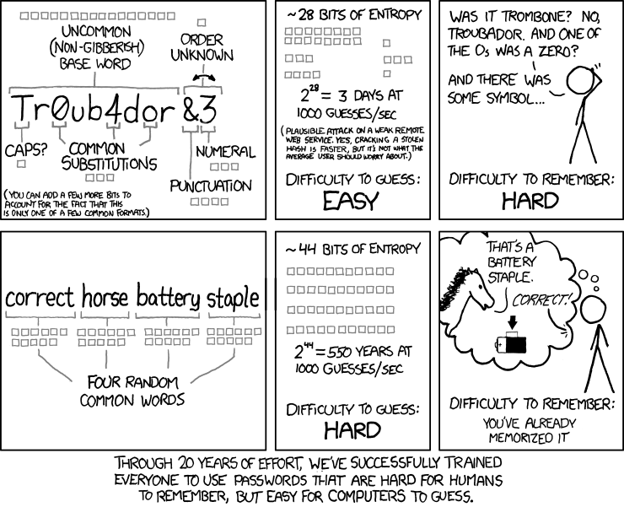
Notes:
https://xkcd.com/936/

Slide 40
Today’s Goals
By the end of class, you will be able to:
Return a file's metadata using the os.stat() function
Use functions to get the size of a file, when it was last accessed, and when it was last modified
Convert dates and times from one format to another using the the datetime module
Remove files from a system using the os.remove() function.
Extract zip files using the zipfile module.
Notes:
Review goals; address any questions.

Slide 41
Activity: XKCD Passwords (40 min)
In this activity, you will create a robust random-password generator by taking two text files full of common nouns in the English language, combine them together into a single list, and then select four random words from within it to create a new string.
Instructions:
This application will require the secrets, os, and zipfile modules.
The following are three definitive parts to this application:
The first part connects to the zip file provided and extracts all of its contents
The second part builds a complete word list by looping through the text files that were originally stored within the zip file
The third part randomly selects four words from the complete word list, puts them together into a single string, and then prints the result to the terminal.
Hints:
This is a challenging activity, and will likely take quite some time to finish. Feel free to work in groups!
Remember to test your application often to ensure it is working properly. Do not try and write the entire program in one go.
Parts of this code are similar to activities you have done previously. Feel free to look back at your previous code for ideas on how you could potentially solve this problem.

Slide 42
XKCD Passwords
Instructor Review

Slide 43
Today’s Goals
By the end of class, you will be able to:
Return a file's metadata using the os.stat() function
Use functions to get the size of a file, when it was last accessed, and when it was last modified
Convert dates and times from one format to another using the the datetime module
Remove files from a system using the os.remove() function.
Extract zip files using the zipfile module.
Notes:
Review goals; address any questions.

Slide 44
For Next Class
Install VirtualBox and boot up Kali Linux
Install VirtualBox
https://www.virtualbox.org/wiki/Downloads
Install VirtualBox VBox Extension Pack
https://download.virtualbox.org/virtualbox/5.2.22/Oracle_VM_VirtualBox_Extension_Pack-5.2.22.vbox-extpack
Kali VBox Image:
https://www.offensive-security.com/kali-linux-vm-vmware-virtualbox-image-download/
Instructions: https://linuxconfig.org/how-to-install-kali-linux-on-virtualbox
Please come to office hours if you want help
installing and with set up!
Notes:
Review goals; address any questions.

